Slide 1
CONTROL TOWER
USER MANUAL
Projects

Slide 2
Projects
Main Sessions
Material Receipt At Port
Material Shipment

Slide 3
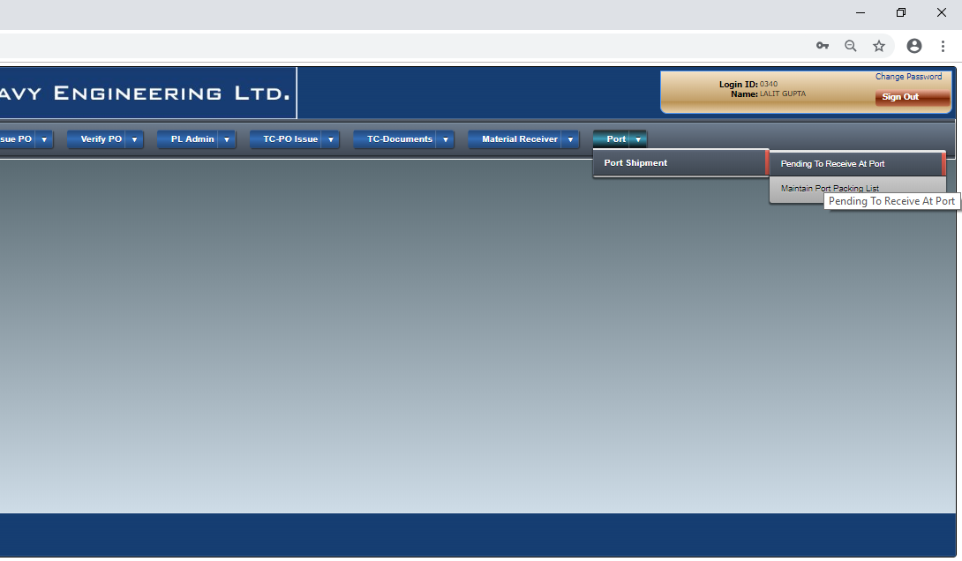
Material Receipt At Port
Select the Menu Option PENDING TO RECEIVE AT PORT

Slide 4
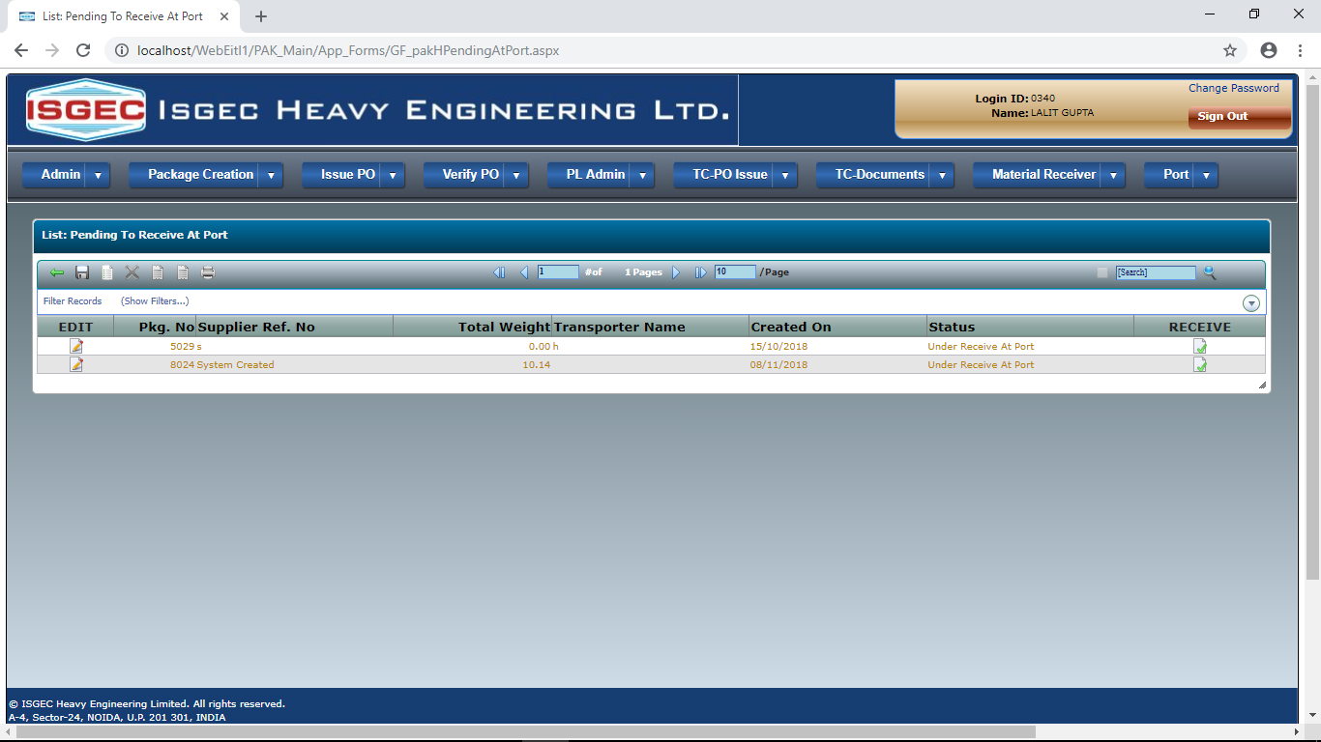
Session will show all despatches from supplier to that PORT
Click on RECEIVE button to Receive Material at that PORT.

Slide 5
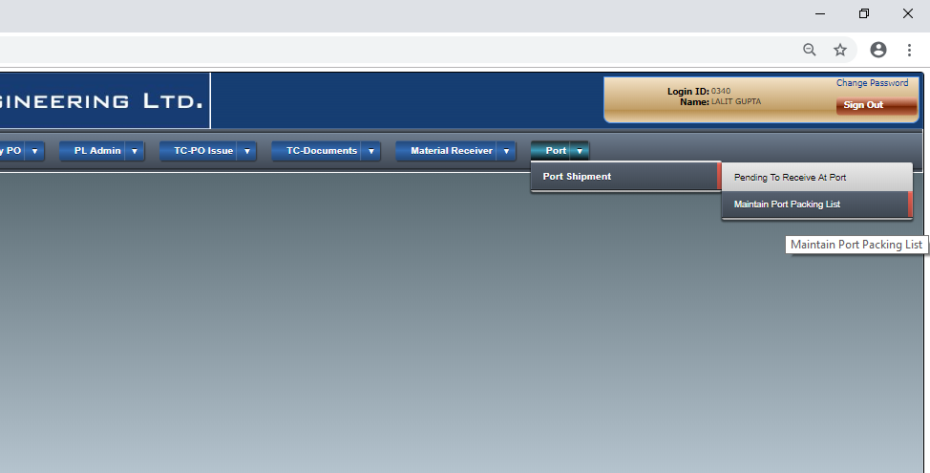
Material Shipment
Click on Maintain Port Packing List Menu Option.

Slide 6
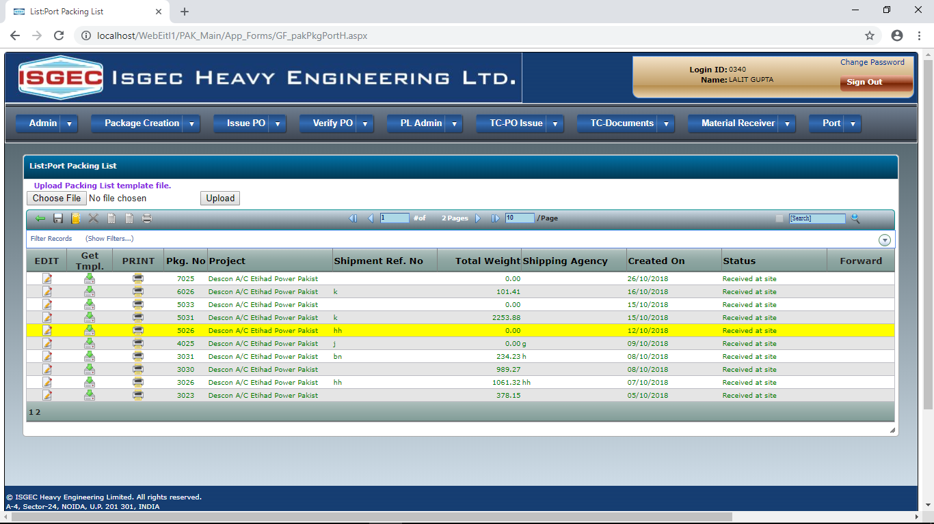
Session shows already created Shipment Records from this PORT.
Click button to Create NEW Shipment Record.

Slide 7
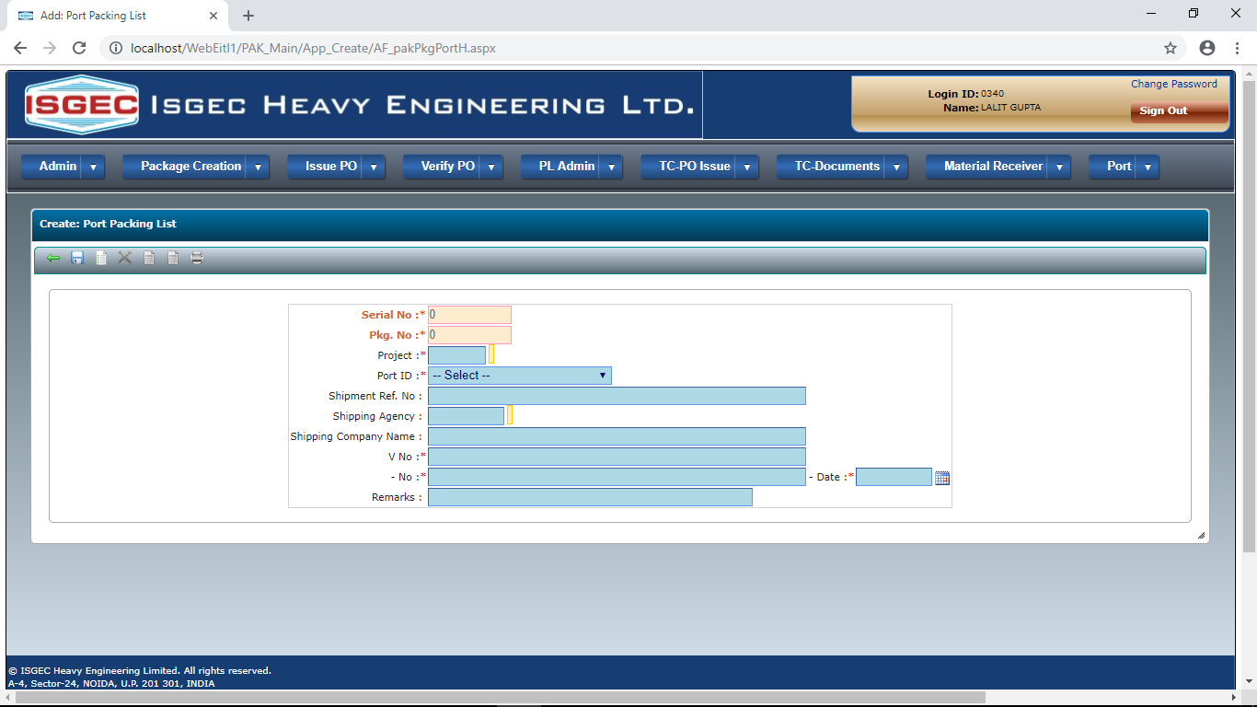
Fill the Project ID and Shipment Details. * Marked Fields are Mandatory.
Click on SAVE button to save the record.

Slide 8
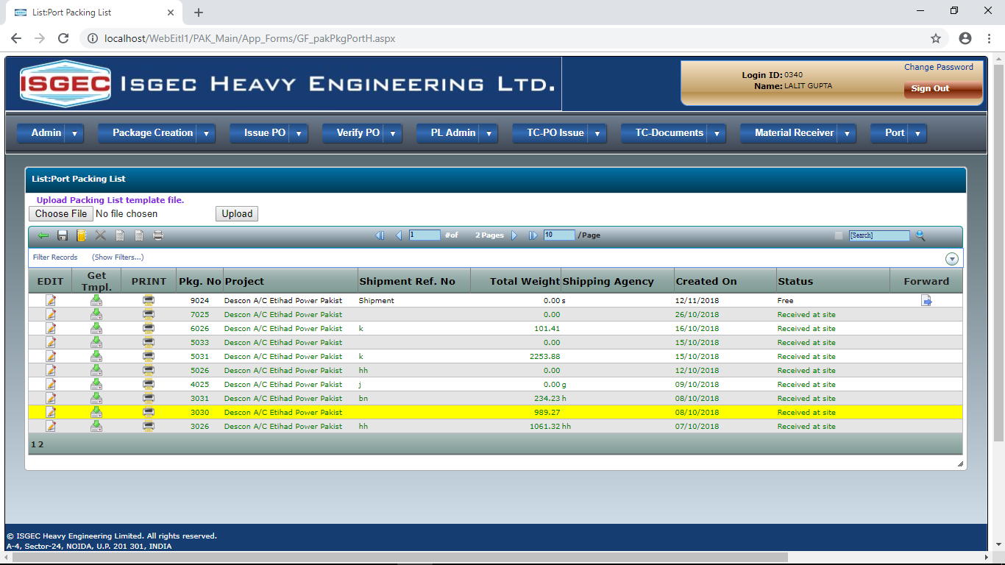
A new record will appear at the TOP of list.
Click on Get Tmpl. To download EXCEL file.

Slide 9
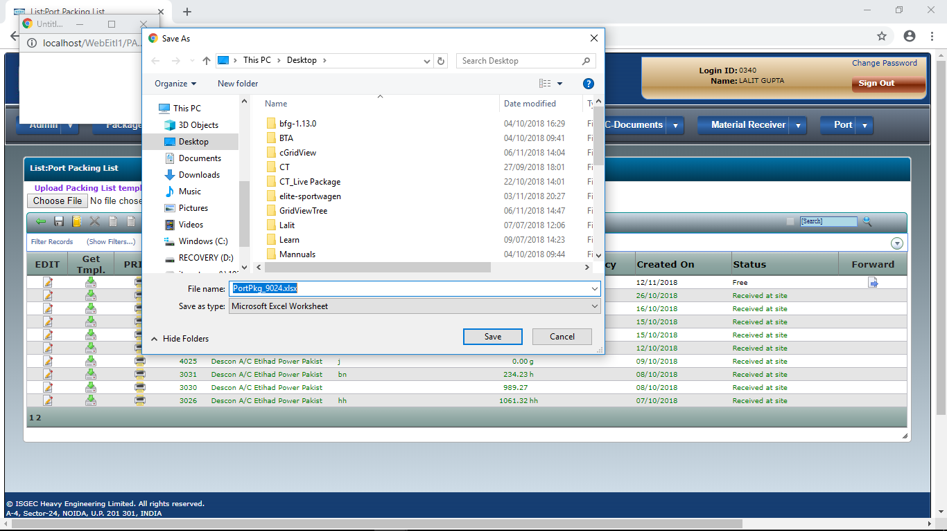
Save and Open the Excel Template File.

Slide 10
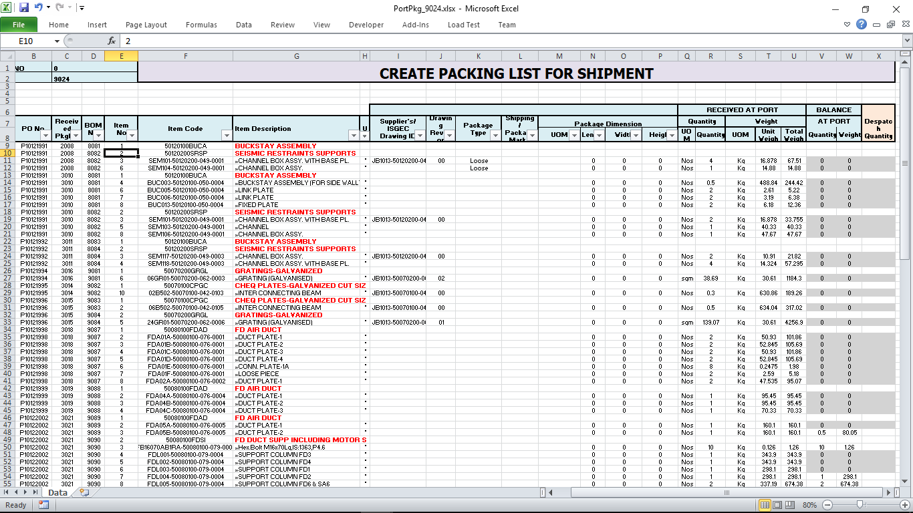
Template file will show List of all Items Received for Project at this Port.
It will show Received Quantity, Balance after shipment.
Fill the quantity to be shipped now, Do not type any thing if the Item is not no be shipped.

Slide 11
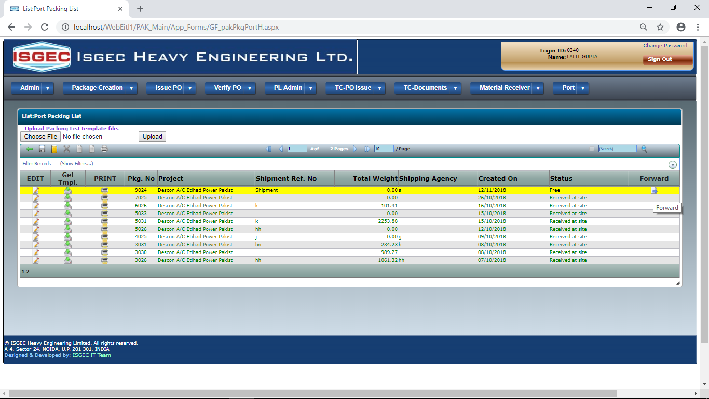
Upload the filled Excel Template.
Click on Choose File/Browse button, locate Excel file.
Then click on Upload Button.

Slide 12
Click on Edit Button to view Uploaded Items and Quantity.

Slide 13
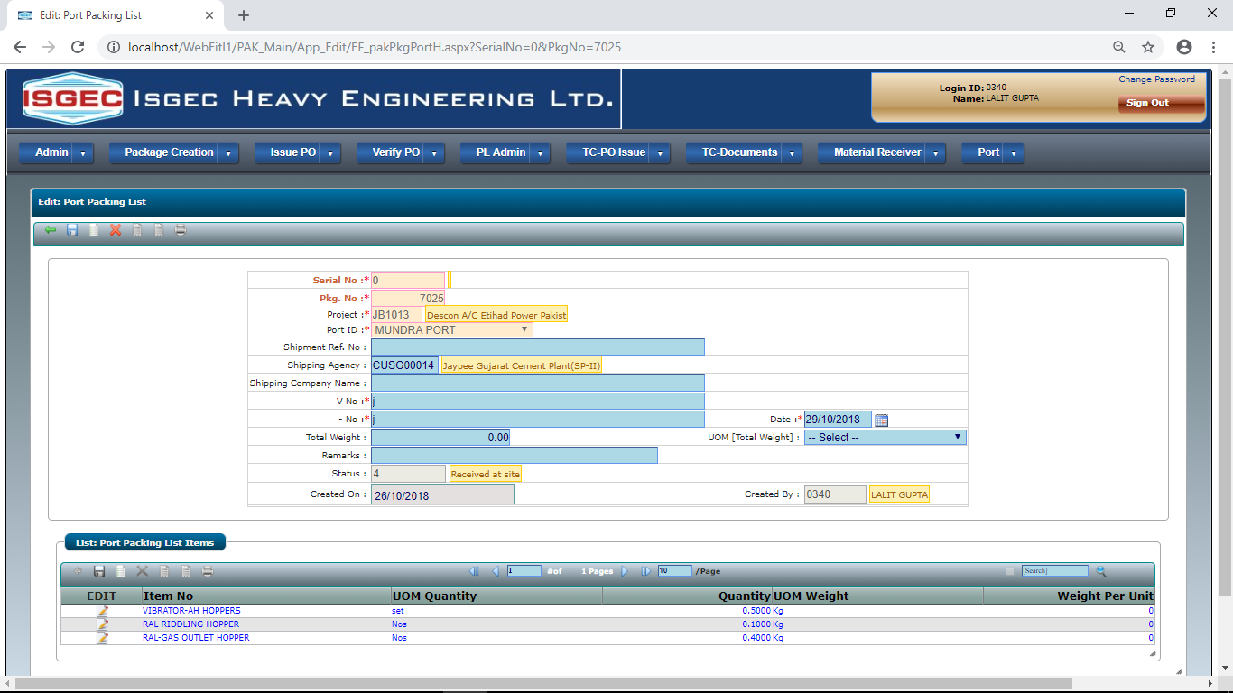
Uploaded Items will be shown here.

Slide 14
Click on the Forward Button to complete the shipment process.

Slide 15
END

